Slide 2
Make a Focus Group Agenda
Working as a group, make an agenda of activities for a focus group. Plan a two-hour focus group for six parents of:
Children who will enter class one (first grade) in the next year
Children who do not now understand English well enough to study in that medium
Write your focus group agenda on the slide provided.
Take 30 minutes. Be ready to explain your reasons for your decisions when we come back to the main room

Slide 3
Example Focus Group Agenda

Slide 4
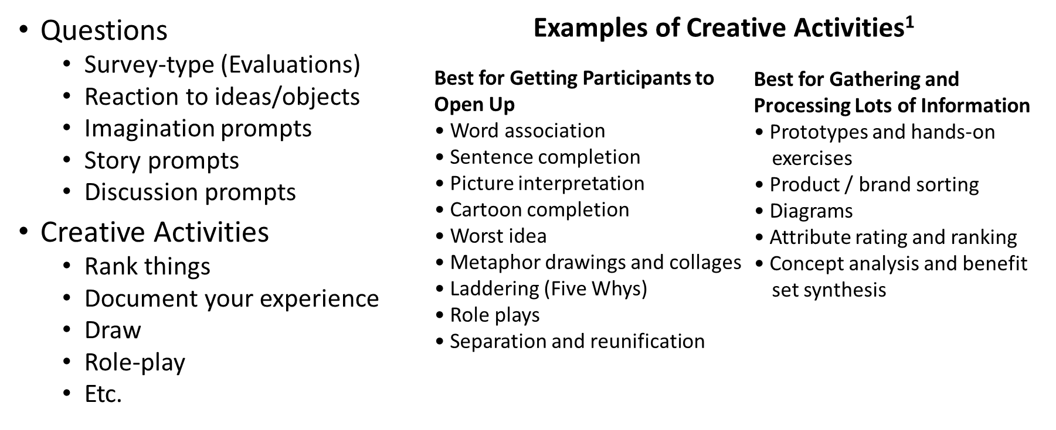
Examples of Focus Group Activities
¹http://www.hinesandlee.com/sites/default/files/Hines%2BLee-CreativeExercises.pdf

Slide 5
Detailed Instructions for Breakout Group Activity
Finish filling all three columns on the next slide.
Add activities that will lead panelists to reveal their thoughts, feelings and actions about issues that are relevant to their children’s preparedness for English medium instruction in class one (first grade). Refer to the types of activities on the previous slide. Don’t just write the TYPE of activity. For example, don’t write only “Drawing exercise”. Describe the activity.
Assign an estimated time to each activity. The total time taken for all the activities must be 120 minutes (two hours).
Take 30 minutes. Be prepared to explain the actions you expect the panelists to do and the things you hope to learn from each exercise.

Slide 6
Your Focus Group Agenda
Write the actual activities you will assign to your panelists in a 60-minute focus group for parents of preschool (. Here is a sample to guide you.
We Need to Know…
We Should Assign Them To…
Minutes
Parents
Their thoughts and feelings about primary education
Priorities which enable children to understand or receive the instructions in English
Reasons why children are unable to understand or receive the instructions in English
Their thoughts to make children able to understand or receive the instructions in English
Each one draw a picture that shows how you feel about Class One (First Grade). Then, show your pictures the group and everyone discuss what your fellow panelists show you.
Rank the things that need to be implemented. So that children will be able to receive and understand the instructions in English
Each one should question(why) and again need to re-question the same question(Laddering)
Each one document your experience. So that children will be able to receive and understand the instructions in English
15
15
15
15

Slide 7
Observation

